Slide 1

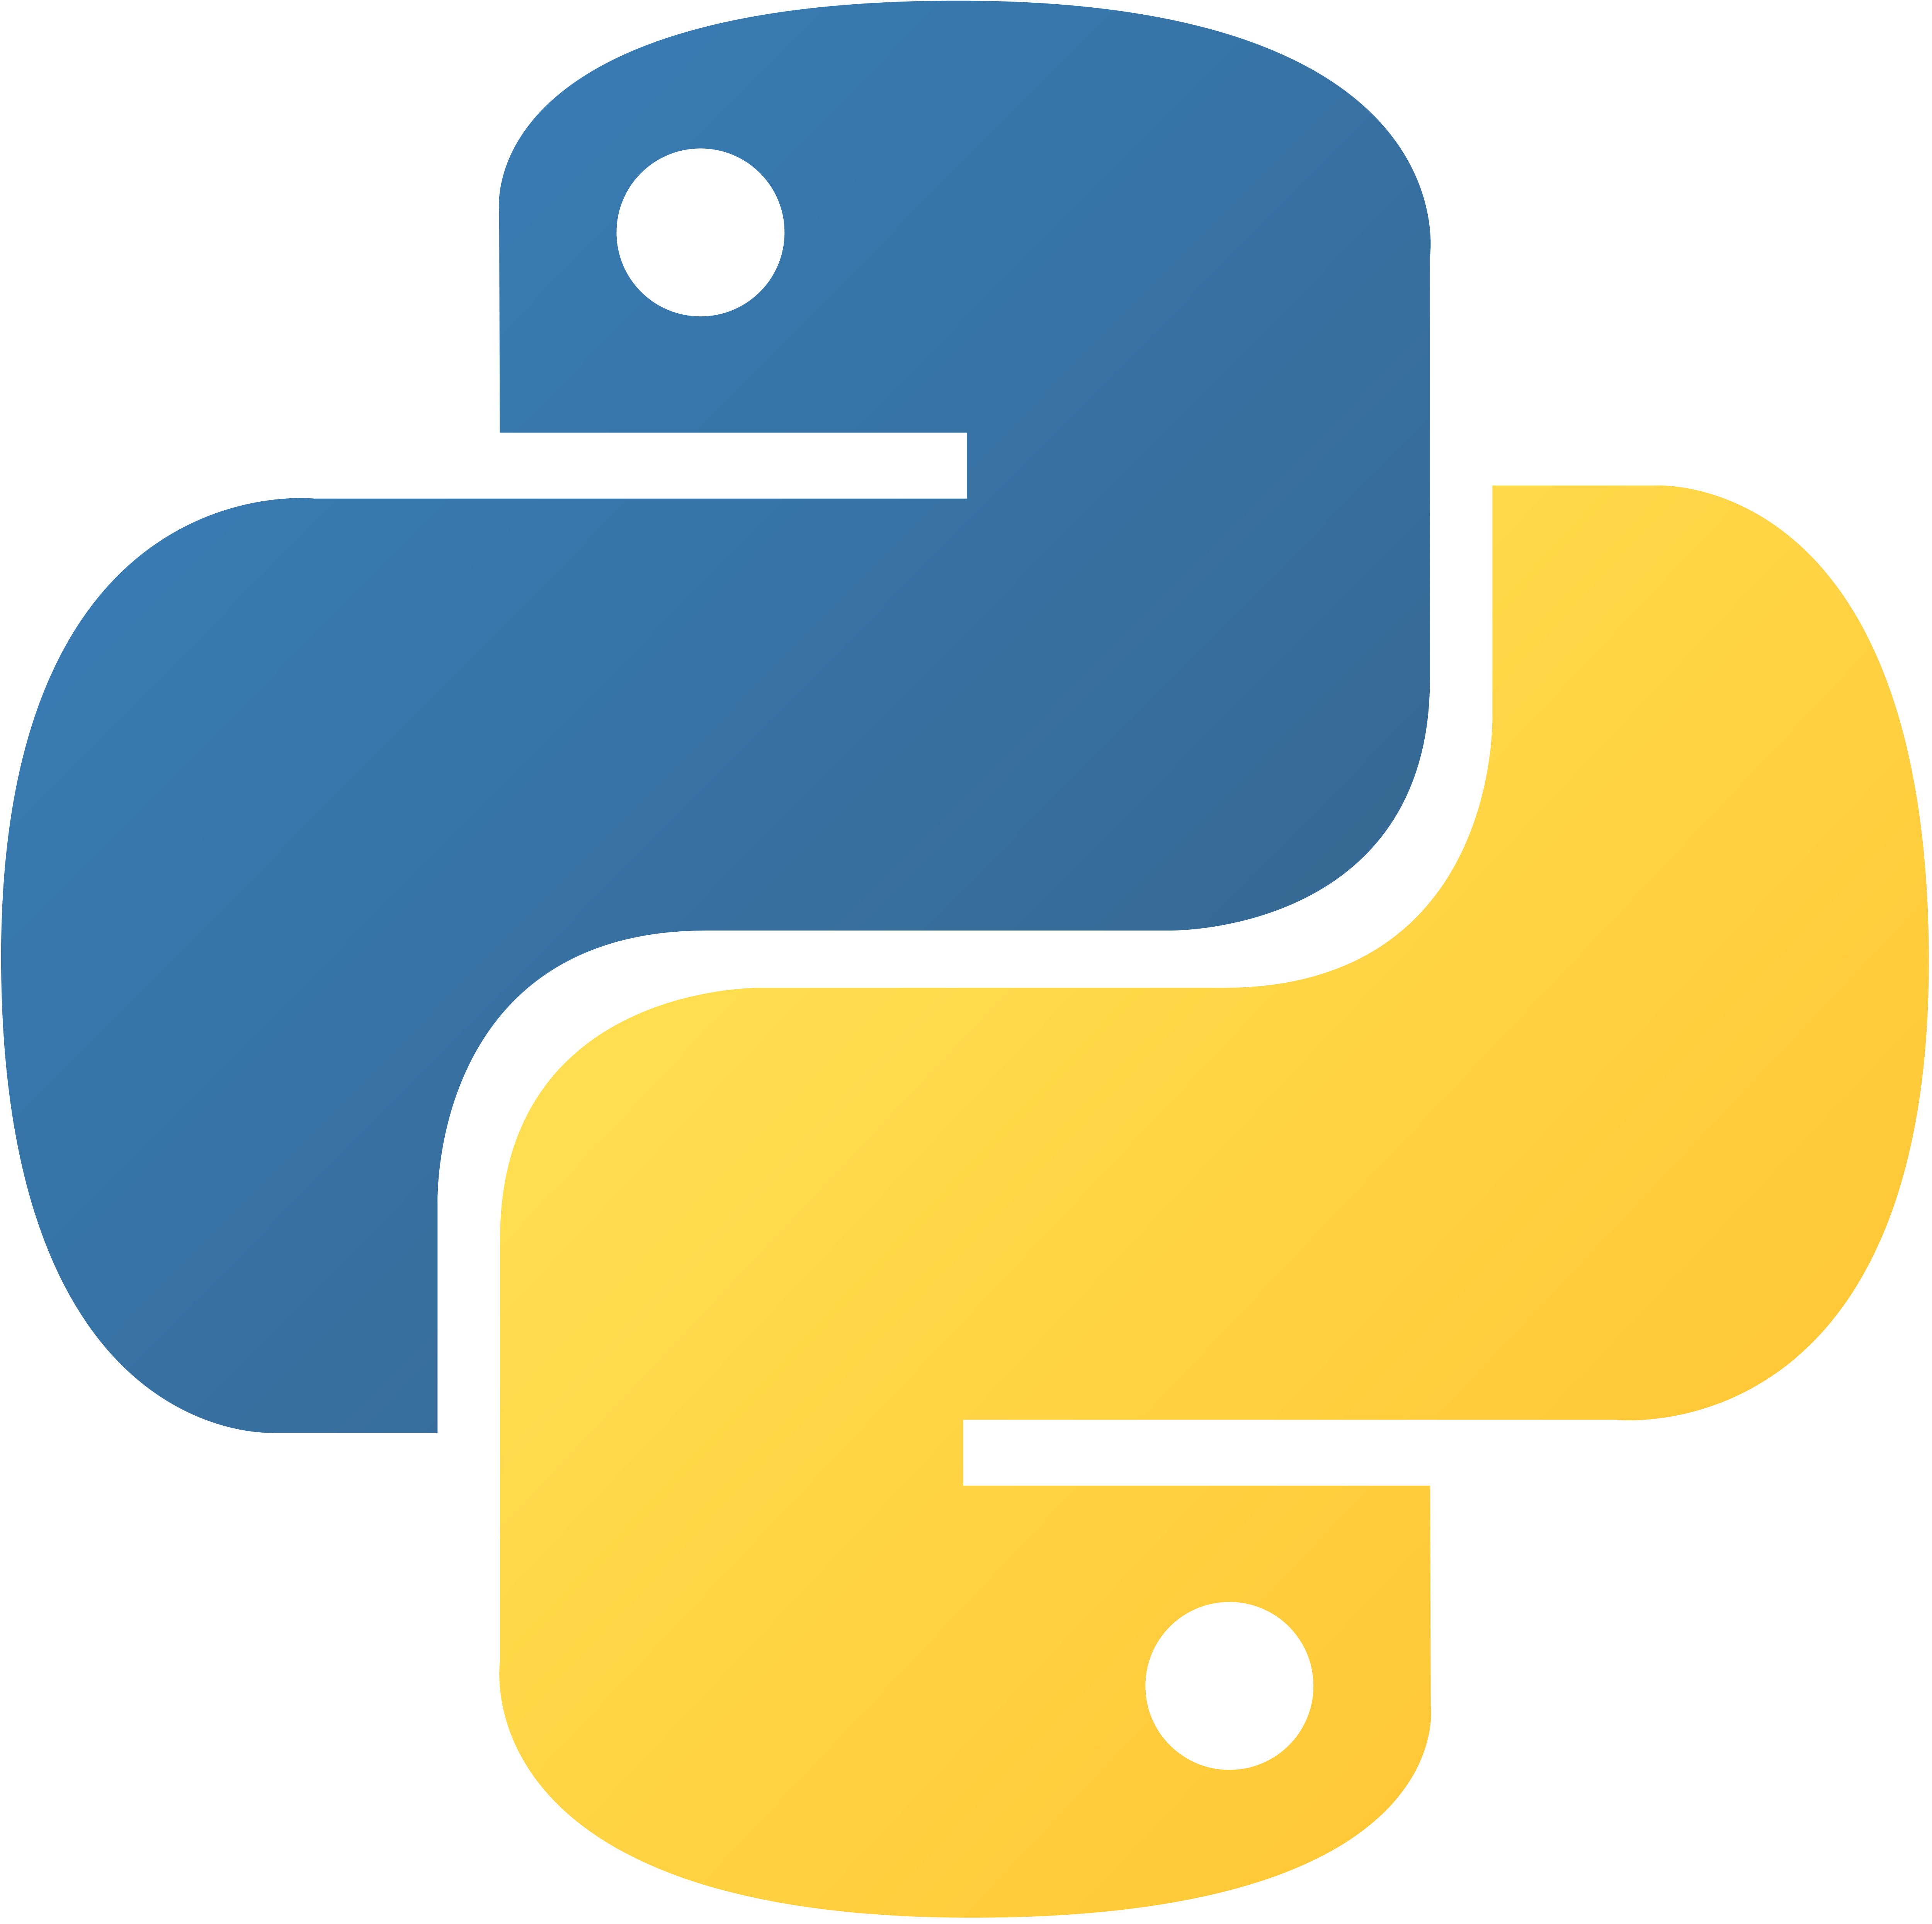
Python sequences

Slide 2
Python Sequences::
In Python, a sequence is a collection of ordered and indexed elements. There are several built-in sequence types in Python, including strings, lists, tuples, and dictonaries.
the second element is at index 1, and so on.
In Python, indexing starts from 0, which means the first element in a sequence is at index 0

Slide 3
List::
It stores values of same data type or different data types(just like a collection of all types of values).
List is iterable. Each index can be iterated using index number. It also allow iteration using negative index.
List is mutable. Elements of a list can be changed.
List is a sequence. But the word “collection” gives a better understanding about list

Slide 4
List Operation::
Creating List:
new_list = [1, 'two' , 3.0] print('Newly created Python list: ',new_list)
Output:
Newly created Python list: [1, 'two', 3.0]
Creating Empty List:
a = [] print("Value of a:" , a) print("Type of a:", type(a)) print("size of a:", len(a))
Output:
Value of a: []
Type of a: <class 'list'>
size of a: 0

Slide 5
List Operation::
Iterating List:
List can be iterated using index number. It also allow iteration using negative index. Let’s consider a list named c.
normal iteration
c[0]
c[1]
c[2]
c[3]
c[4]
c[5]
1
3
5
7.3
japan
china
c[-6]
c[-5]
c[-4]
c[-3]
c[-2]
c[-1]
iteration using negative index
c = [1 , 3 , 5 ,7.3 , 'japan' , 'china'] print(c[3]) print(c[-2])
Output:
7.3
japan

Slide 6
List Operation::
Inserting into List
New elements can be inserted into list. This can be done using append( ) method. This method inserts the new value at the end of the list.
c.append(20)
c[0]
c[1]
c[2]
c[3]
c[4]
c[5]
c[6]
1
3
4
7
japan
china
c = [1 , 3 , 5 ,7 , 'japan' , 'china'] c.append(20) print(c)
Output:
[1, 3, 5, 7, 'japan', 'china', 20]

Slide 7
List Operation::
List are mutable
The value of any index of a list can be replaced by another value using index number.
c[0]
c[1]
c[2]
fruit =
banana
apple
cherry
fruit = ["banana", "apple", "cherry"] print(fruit) fruit[0] = "pear" fruit[-1] = "orange" print(fruit)
c[0]
c[1]
c[2]
c[0] = ‘pear’
banana
apple
cherry
c[0]
c[1]
c[2]
c[-1] = ‘orange’
banana
apple
cherry
Output:
['banana', 'apple', 'cherry']
['pear', 'apple', 'orange']

Slide 8
Tuples:
Tuple is one of 4 built-in data types in Python used to store collections of data, the other 3 are List, Set, and Dictionary, all with different qualities and usage.
A tuple is a collection which is ordered and unchangeable.
Tuples are written with round brackets.
Tuples are used to store multiple items in a single variable.

Slide 9
Tuples Operation::
Creating tuples:
Create a tuple with employee id, name, age, salary deatels
employee_deatels =(‘P001’, ‘John’ ,35,40000)
Print the tuple
print(employee_deatels )
Output:(‘P001’, ‘John’ ,35,40000)

Slide 10
example = "apple", "orange", "banana", "berry", "mango"
print (example[0]);
Output:‘apple’
In the table below we have marked the tuple elements for both forward and backward indexing:
Value | Forward Indexing | Backward Indexing
apple | 0 | -5
orange | 1 | -4
banana | 2 | -3
berry | 3 | -2
mango | 4 | -1

Slide 11
Tuple Length:
To determine how many items a tuple has, use the len() function:
thistuple = ("apple", "banana", "cherry") print(len(thistuple))
Output:3
Create Tuple With One Item:
To create a tuple with only one item, you have to add a comma after the item, otherwise Python will not recognize it as a tuple.
thistuple = ("apple",) print(type(thistuple)) #NOT a tuple thistuple = ("apple") print(type(thistuple))
Output:<class ‘tuple’>
<class ‘str’>

Slide 12
The tuple() Constructor:
It is also possible to use the tuple() constructor to make a tuple.
Example:
Using the tuple() method to make a tuple:
thistuple = tuple(("apple", "banana", "cherry")) print(thistuple)
Output:('apple', 'banana', 'cherry’)

Slide 13
Dictionary::
A dictionary is a collection which is ordered*, changeable and do not allow duplicates.
As of Python version 3.7, dictionaries are ordered. In Python 3.6 and earlier, dictionaries are unordered.
Dictionaries are written with curly brackets, and have keys and values.
Dictionaries are used to store data values in key : value pairs.

Slide 14
Dictionary Operation::
Create and print a dictionary:
thisdict = { "brand": "Ford", "model": "Mustang", "year": 1964 } print(thisdict)
Output:{'brand': 'Ford', 'model': 'Mustang', 'year': 1964}

Slide 15
Dictionary Operation::
Dictionary Items:
Dictionary items are ordered, changeable, and does not allow duplicates.
Dictionary items are presented in key:value pairs, and can be referred to by using the key name.
Example:
Print the "brand" value of the dictionary:
thisdict = { "brand": "Ford", "model": "Mustang", "year": 1964 } print(thisdict["brand"])
Output:Ford

Slide 16
Dictionary Operation::
Dictionary Items - Data Types:
The values in dictionary items can be of any data type:
Example:
String, int, boolean, and list data types:
thisdict = { "brand": "Ford", "electric": False, "year": 1964, "colors": ["red", "white", "blue"] }
Output:{'brand': 'Ford', 'electric': False, 'year': 1964, 'colors': ['red', 'white', 'blue']}

Slide 17
Dictionary Operation::
The dict() Constructor
It is also possible to use the dict() constructor to make a dictionary.
Example:
Using the dict() method to make a dictionary:
thisdict = dict(name = "John", age = 36, country = "Norway") print(thisdict)
Output:{'name': 'John', 'age': 36, 'country': 'Norway'}

Slide 18
Thank you

